Slide 1
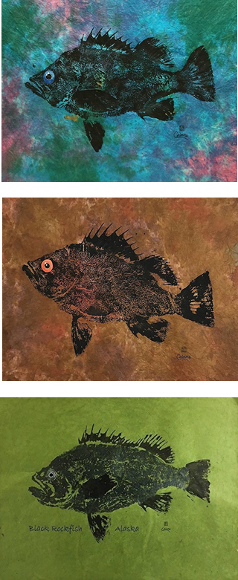
Accounting for population dynamics improves the use of no-take marine reserves for fishery management
Victoria Quennessen
MS Student in Fisheries Science
Hotel Coral y Marina, Ensenada, Mexico
Western Society of Naturalists
November 2nd, 2019

Slide 2
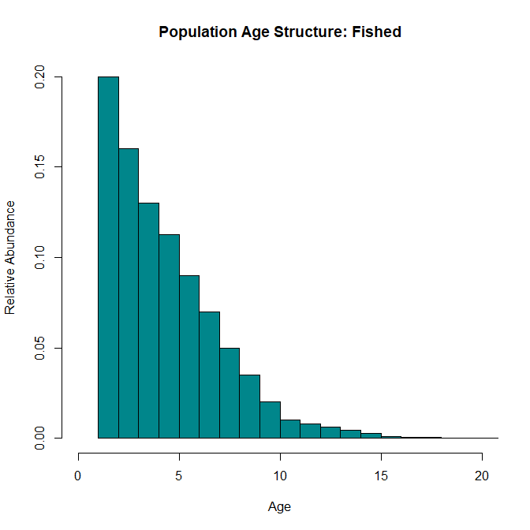
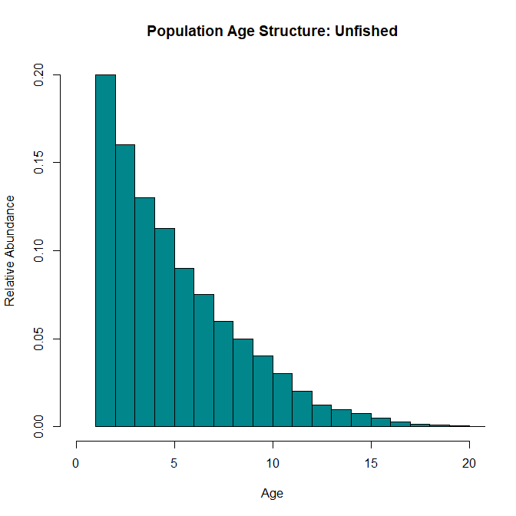
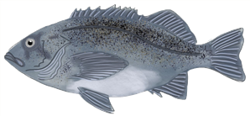
Effects of Fishing
Background
Methods
Results
Next Steps
Question
Conclusions
Bigger, older individuals
Notes:
Age structure naturally decreases as fish die from predation, cannibalism, lack of food, competition for habitat, etc…

Slide 3
Effects of Fishing
Background
Methods
Results
Next Steps
Question
Conclusions
Bigger, older individuals
Notes:
Effects of fishing (evenly across ages)
Truncation of age structure – since there are already less BOFFFFs, fishing disproportionately affects them
Decreased biomass and abundance
Decreased resilience to environmental perturbations
Increased amplitude of natural fluctuations in population size which reduces our ability to predict population trends
Growing emphasis on use of marine protected areas (MPAs) to protect fisheries and reduce effects of fishing pressure
149 studies on 124 MPAs in 29 countries
As of 2015, 3.5% of world’s oceans in MPAs, about 1.6% strongly or fully protected (Lubchenco and Grorud-Colvert, 2015)

Slide 4
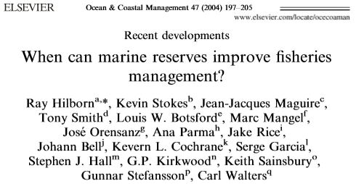
Effects of Fishing
Background
Methods
Results
Next Steps
Question
Conclusions
Bigger, older individuals
Notes:
Growing emphasis on use of marine protected areas (MPAs) to protect fisheries and reduce effects of fishing pressure
149 studies on 124 MPAs in 29 countries
As of 2015, 3.5% of world’s oceans in MPAs, about 1.6% strongly or fully protected (Lubchenco and Grorud-Colvert, 2015)
However, current research is still trying to evaluate how best to incorporate MPAs into fisheries management
When do MPAs help?

Slide 5
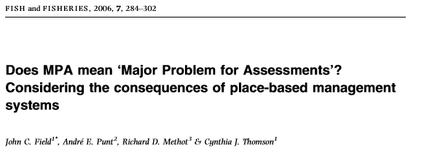
Effects of Fishing
Background
Methods
Results
Next Steps
Question
Conclusions
Bigger, older individuals
Notes:
Growing emphasis on use of marine protected areas (MPAs) to protect fisheries and reduce effects of fishing pressure
149 studies on 124 MPAs in 29 countries
As of 2015, 3.5% of world’s oceans in MPAs, about 1.6% strongly or fully protected (Lubchenco and Grorud-Colvert, 2015)
However, current research is still trying to evaluate how best to incorporate MPAs into fisheries management
When do MPAs help?
When do they complicate assessment and therefore management?

Slide 6
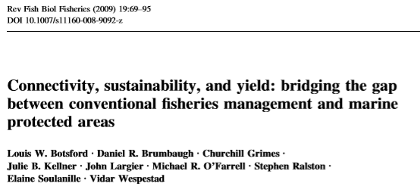
Effects of Fishing
Background
Methods
Results
Next Steps
Question
Conclusions
Bigger, older individuals
Notes:
Growing emphasis on use of marine protected areas (MPAs) to protect fisheries and reduce effects of fishing pressure
149 studies on 124 MPAs in 29 countries
As of 2015, 3.5% of world’s oceans in MPAs, about 1.6% strongly or fully protected (Lubchenco and Grorud-Colvert, 2015)
However, current research is still trying to evaluate how best to incorporate MPAs into fisheries management
When do MPAs help?
When do they complicate assessment and therefore management?
How can we bridge the gap?

Slide 7
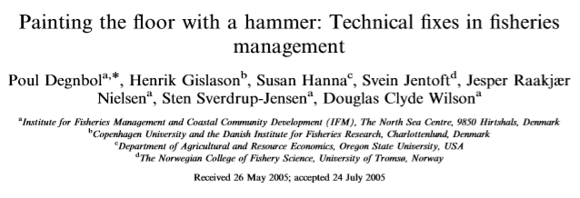
Effects of Fishing
Background
Methods
Results
Next Steps
Question
Conclusions
Bigger, older individuals
Notes:
Growing emphasis on use of marine protected areas (MPAs) to protect fisheries and reduce effects of fishing pressure
149 studies on 124 MPAs in 29 countries
As of 2015, 3.5% of world’s oceans in MPAs, about 1.6% strongly or fully protected (Lubchenco and Grorud-Colvert, 2015)
However, current research is still trying to evaluate how best to incorporate MPAs into fisheries management
When do MPAs help?
When do they complicate assessment and therefore management?
How can we bridge the gap?
And under what circumstances do they help the most, compared to other management techniques like Individual transferable quotas, community-based management, or combinations of them?

Slide 8
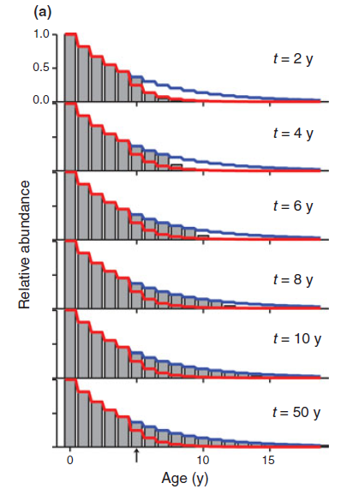
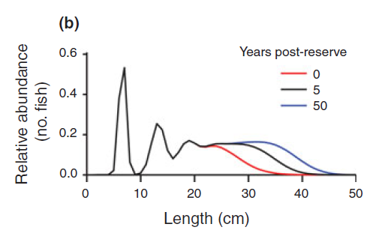
Background
Methods
Results
Next Steps
Question
Conclusions
Transient Dynamics
White et al., 2013
Notes:
Understanding transient dynamics can help us start to fill in this gap in knowledge
After protections, age structure fills back in over time (red line = fished, blue = unfished)
We know that the rate at which the age structure fills in depends on several life history characteristics, such as natural mortality rate
While the age structure fills back in, we get transient dynamics, which are different from the equilibrium dynamics that most fishery models use after reserve implementation
These transient dynamics amplify fluctuations in the population that could complicate fishery management

Slide 9
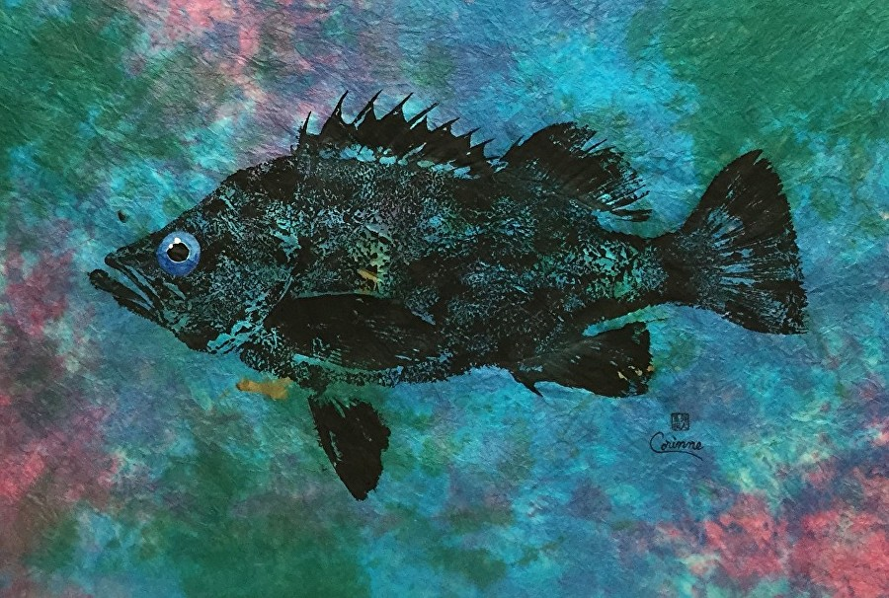
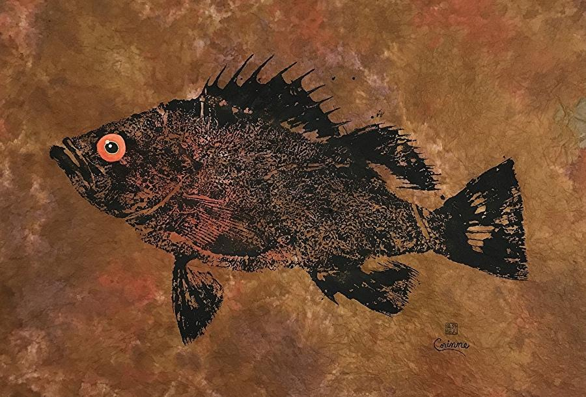
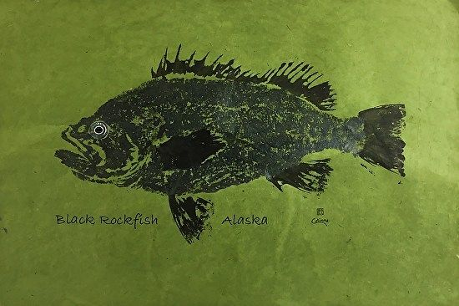
Background
Methods
Results
Next Steps
Question
Conclusions
Objectives / research questions
How can we best use information from within reserves to help adaptively manage fisheries following reserve implementation?
How does the inclusion of transient dynamics influence the short-term effect of control rules on yield and biomass?
What happens when we don’t have an accurate estimate of M for a fished species?

Slide 10
1. Build base model
Background
Methods
Results
Next Steps
Question
Conclusions
Population dynamics
Imperfect sampling
Current west coast groundfish fishery has 40:10 control rule
Density ratio as metric to assess level of depletion:
# ind./ area outside reserve
-------------------------------------
# ind./ area inside reserve
Management (control rules)
Fishing
Adapted from Babcock & MacCall 2011
Notes:
Model
Translated from Visual Basic
Based on life history characteristics of Black Rockfish
has 4 submodels
- Imperfect sampling produces *some* reference point
Current control rule:
Fishing effort is reduced for stocks below a certain threshold (B40%, or 40% of unfished biomass) until it hits B10%, after which the fishery is closed completely
Problem: difficult to know unfished biomass – most data aren’t collected until after harvesting begins
New control rule: sets target Density Ratio as opposed to proportion of unfished biomass
Useful because we don’t have to have a long history of catch or abundance data
Can also be applied to more local spatial scales relevant to marine reserves and recruitment pulses

Slide 11
2. Apply transient dynamics to control rules
Background
Methods
Results
Next Steps
Question
Conclusions
CR | 1 | 2 | 3 | 4 | 5 | 6
Type | Babcock & MacCall | Babcock & MacCall | Babcock & MacCall | Transient | Transient | Transient
M | Low | Correct | High | Low | Correct | High
Adapted from Babcock & MacCall 2011
$$Target DR=1 −\left(1 −Final DR\right)∗( e^{−Mt})$$
Adapted from White et al. 2013
Notes:
Target DR = moving target over time
Final DR = eventual DR to be used once transitioned to unfished equilibrium dynamics
M = natural mortality rate
T = years since reserve implementation
T = 0, Target DR = 1
T = high enough, Target DR = Final DR (depends on M value)
Ran many simulations on a server

Slide 12
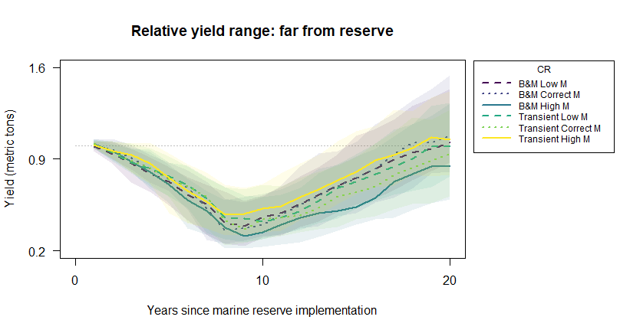
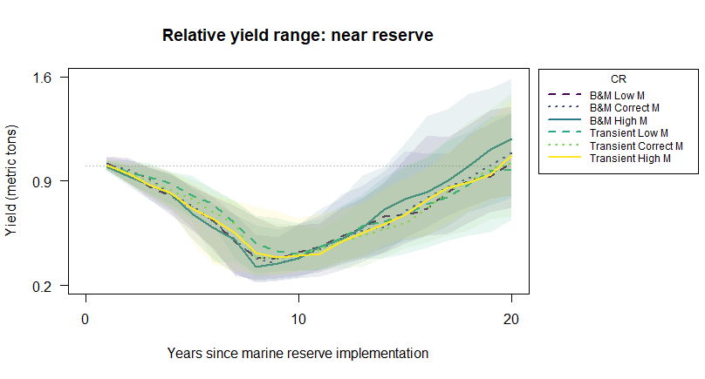
Transient dynamics - yield
Background
Methods
Results
Next Steps
Question
Conclusions
Notes:
Preliminary results
- Line is median over all the runs, shaded area shows the interquartile range
- Overlap due to recruitment variability
- Transient DR leads to higher relative yield when M is estimated as higher than true M

Slide 13
Transient dynamics - yield
Background
Methods
Results
Next Steps
Question
Conclusions
Notes:
- Overlap due to recruitment variability
Transient DR does better for all estimates of M immediately following reserve implementation (first 10ish years)

Slide 14
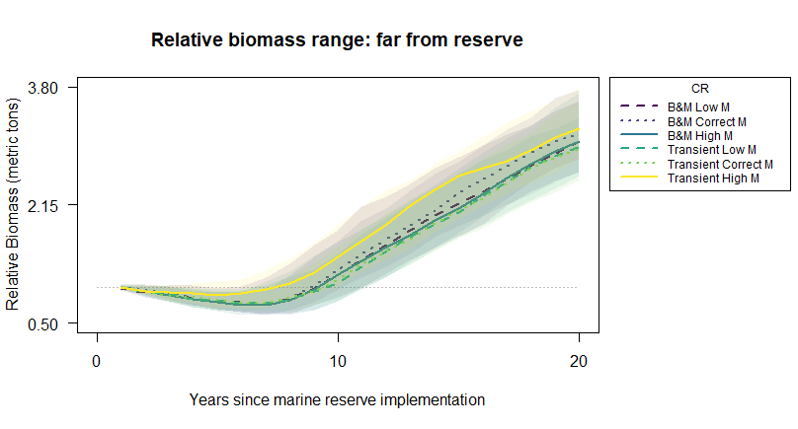
Transient dynamics - biomass
Background
Methods
Results
Next Steps
Question
Conclusions
Notes:
- Overlap due to recruitment variability
Transient DR works better when M is overestimated

Slide 15
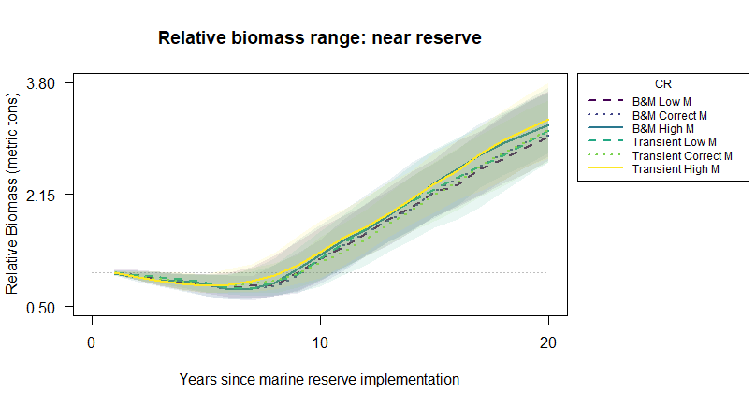
Transient dynamics - biomass
Background
Methods
Results
Next Steps
Question
Conclusions
Notes:
recruitment variability causes much overlap, but
Transient DR works consistently better than B&M control rule for all estimates on average

Slide 16
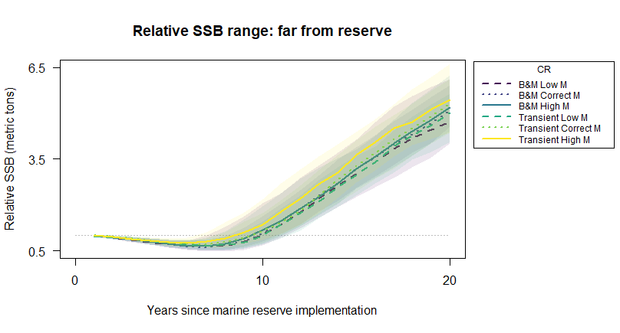
Transient dynamics – spawning stock biomass
Background
Methods
Results
Next Steps
Question
Conclusions
Notes:
recruitment variability causes much overlap, but
Transient DR works consistently better than B&M control rule for all estimates on average

Slide 17
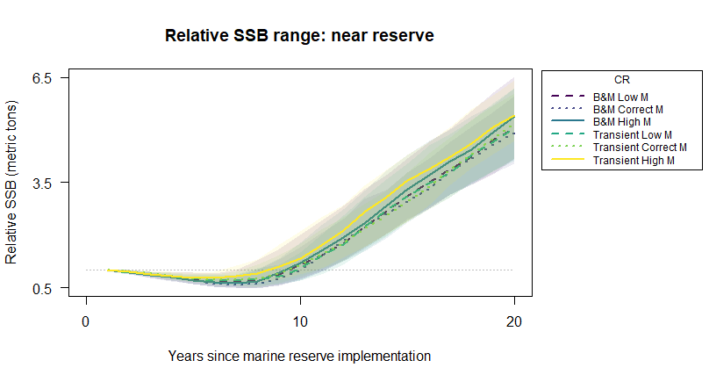
Transient dynamics – spawning stock biomass
Background
Methods
Results
Next Steps
Question
Conclusions
Notes:
recruitment variability causes much overlap, but
Transient DR works consistently better than B&M control rule for all estimates on average

Slide 18

Next steps:
Background
Methods
Results
Next Steps
Question
Conclusions
Run more simulations, with varying degrees of error estimating M
Apply process to different species with different levels of M
Partner with ODFW to prep for 2023 OR marine reserve assessment
Notes:
Define M and k

Slide 19
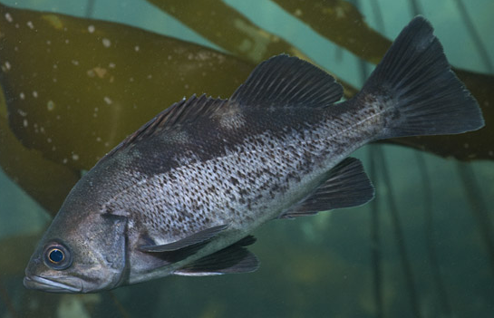
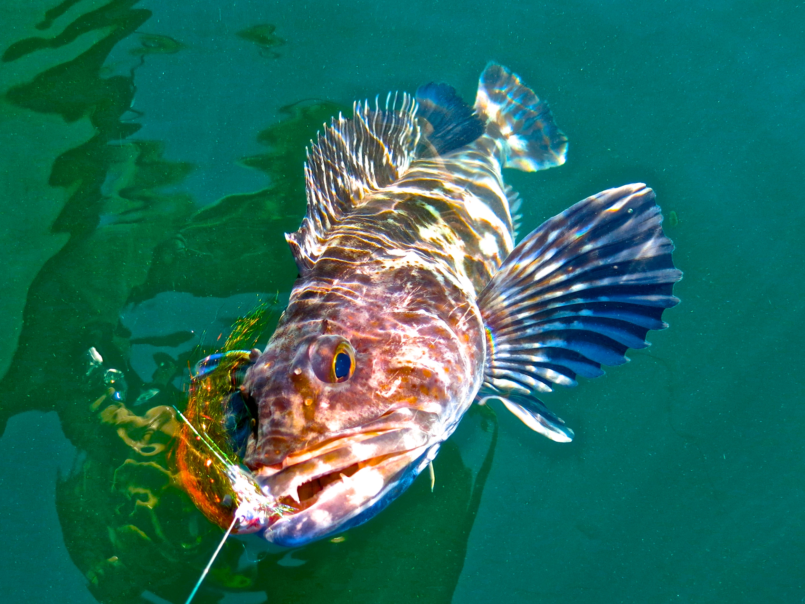
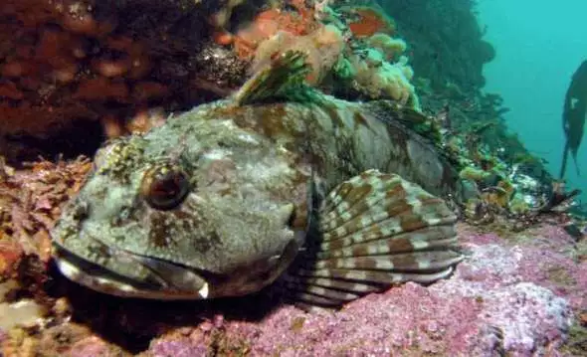
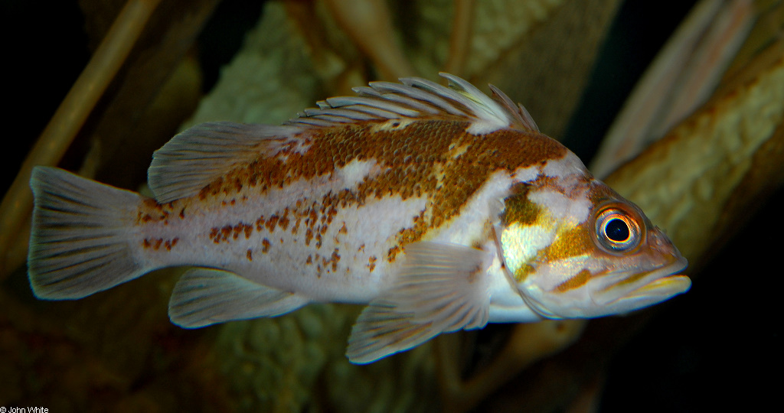
Background
Methods
Results
Next Steps
Question
Conclusions
Transient dynamics can help us to adaptively manage fisheries in and around marine reserves, especially with high estimates of natural mortality.
Levi
Jay Nichols
FishWithJD
John White

